Slide 1


Real-Time Vehicle Classification using CNN
Project By: Sonal S Varghese

Slide 2

Introduction
📌Introduction to the Project:
This project focuses on object classification using Convolutional Neural Networks (CNNs).
The goal is to accurately classify images into different vehicle categories.
Deep learning techniques like Dropout, Batch Normalization, and Early Stopping are used to optimize model performance.
The dataset consists of images of various vehicles and airplanes, ensuring diversity for better model training.
📌Why CNN?
CNNs are powerful for image recognition tasks due to their ability to automatically learn spatial hierarchies of features.
They reduce the need for manual feature extraction, making them ideal for object classification.

Slide 3
Overview of the Project
📌Objective:
Develop a Convolutional Neural Network (CNN) model for object classification.
Train the model to accurately classify objects into predefined categories.
Use Deep Learning techniques to improve accuracy and generalization.
📌Categories Used:
✈Airplane
🚗Car
🚌Bus
🏍Motorcycle
🚛Truck

Slide 4
Presentation Workflow
Data Collection: Gathered images from various sources.
Data Preprocessing: Image resizing, normalization, and augmentation.
Model Training: Implemented CNN with multiple layers.
Optimization: Used techniques like Batch Normalization and Dropout.
Evaluation: Tested model performance using metrics like accuracy and loss.
Implementation: Real-Time classification using webcam

Slide 5


Data Collection
📌 Data Source:
Images were sourced using automated web scraping from Google and DuckDuckGo.
A dataset of five categories was created: Airplane, Car, Bus, Motorcycle and Truck.
Ensured a balanced dataset with 1000 images per category.
📌 Challenges & Solutions:
Issue: Dataset imbalance between categories. ✅ Solution: Ensured a balanced dataset while maintaining real-world variability.
Issue: Noisy and irrelevant images. ✅ Solution: Manually filtered low-quality images and removed duplicates.

Slide 6
Data Preprocessing
Image Resizing: Standardized all images to a fixed resolution. Resized images to a fixed size (150x150).
Normalization: Scaled pixel values to the range [0,1] to improve model stability.
Converted images to NumPy arrays.
Train Test Split: Split dataset into training and test sets.

Slide 7
Model Architecture
Convolutional Neural Network (CNN) Architecture
Input Layer: Image size (e.g., 150x150x3).
Convolutional Layers: Extract spatial features using Conv2D.
Batch Normalization: Stabilizes training and speeds up convergence.
MaxPooling Layers: Reduce spatial dimensions while retaining important features.
Dropout Layers: Prevent overfitting by randomly deactivating neurons.
Flatten Layer: Converts feature maps into a 1D vector.
Fully Connected Layers (Dense): Learn complex patterns and relationships.
Output Layer: Uses SoftMax activation for multi-class classification.

Slide 8
Model Training
Training the CNN Model
Dataset Preparation: Images resized, normalized, and split into training & validation sets.
Loss Function: Categorical Cross-Entropy.
Optimizer: Adam (adaptive learning rate optimization).
Metrics: Accuracy used to evaluate model performance.
Key Techniques Used
Batch Normalization: Stabilizes activations and speeds up training.
Dropout: Prevents overfitting by randomly disabling neurons.
Early Stopping: Stops training when validation loss stops improving.

Slide 9
Model Training
Dropout:
Dropout is a regularization technique that prevents overfitting by randomly setting some neurons' outputs to zero during training.
How it works internally:
During training, for each batch, Dropout randomly selects a fraction of neurons and sets their output to zero.
This forces the network to not rely on specific neurons and instead distribute learning across the model.
At inference (testing) time, no neurons are dropped, but their activations are scaled to compensate for the missing neurons during training.

Slide 10
Model Training
Batch Normalization:
Batch Normalization (BatchNorm) stabilizes learning by normalizing the inputs of each layer to have zero mean and unit variance. Computes mean and variance of activations within a batch.
Why use it?
Helps speed up convergence
Reduces internal covariate shift (i.e., changes in the input distribution)
Can act as a regularizer.

Slide 11
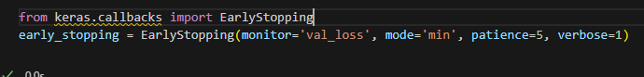
Model Training
Early Stopping:
Early Stopping monitors model performance and stops training when validation loss stops improving, preventing overfitting.
How it works internally:
During training, it checks the validation loss after each epoch.
If the validation loss does not improve for a certain number of epochs (patience value), training stops.
This avoids training for too long, which can lead to overfitting.

Slide 12
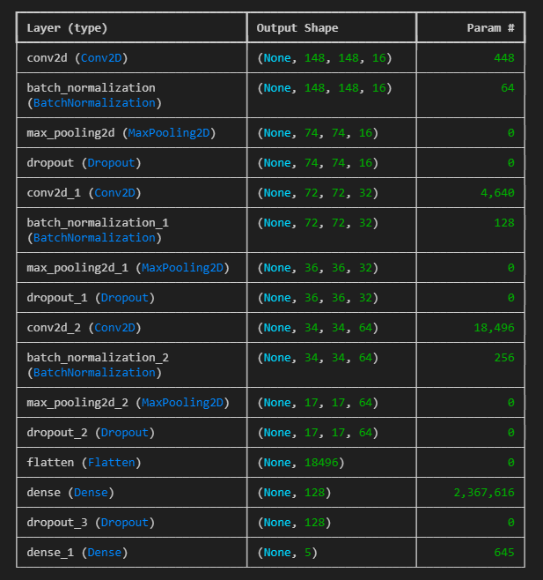
Model Performance
Training Accuracy : 87..84%
Testing Accuracy : 79.96%
Performance Metrics: Accuracy, Loss

Slide 13
Real-Time Implementation
How it Works:
Model takes live input from a camera or video stream.
Classifies objects in real-time.
Displays detected object category with confidence score.

Slide 14
Conclusion & Future Work
Conclusion:
Successfully trained a CNN model for object classification
Achieved a reasonable accuracy
Future Work:
Improve dataset quality
Experiment with different architectures
Deploy model for real-time classification

Slide 15
References
BatchNorm: https://www.geeksforgeeks.org/what-is-batch-normalization-in-deep-learning/
Dropout: https://www.geeksforgeeks.org/dropout-in-neural-networks/
Early Stopping: https://www.geeksforgeeks.org/regularization-by-early-stopping/

